Slide 1
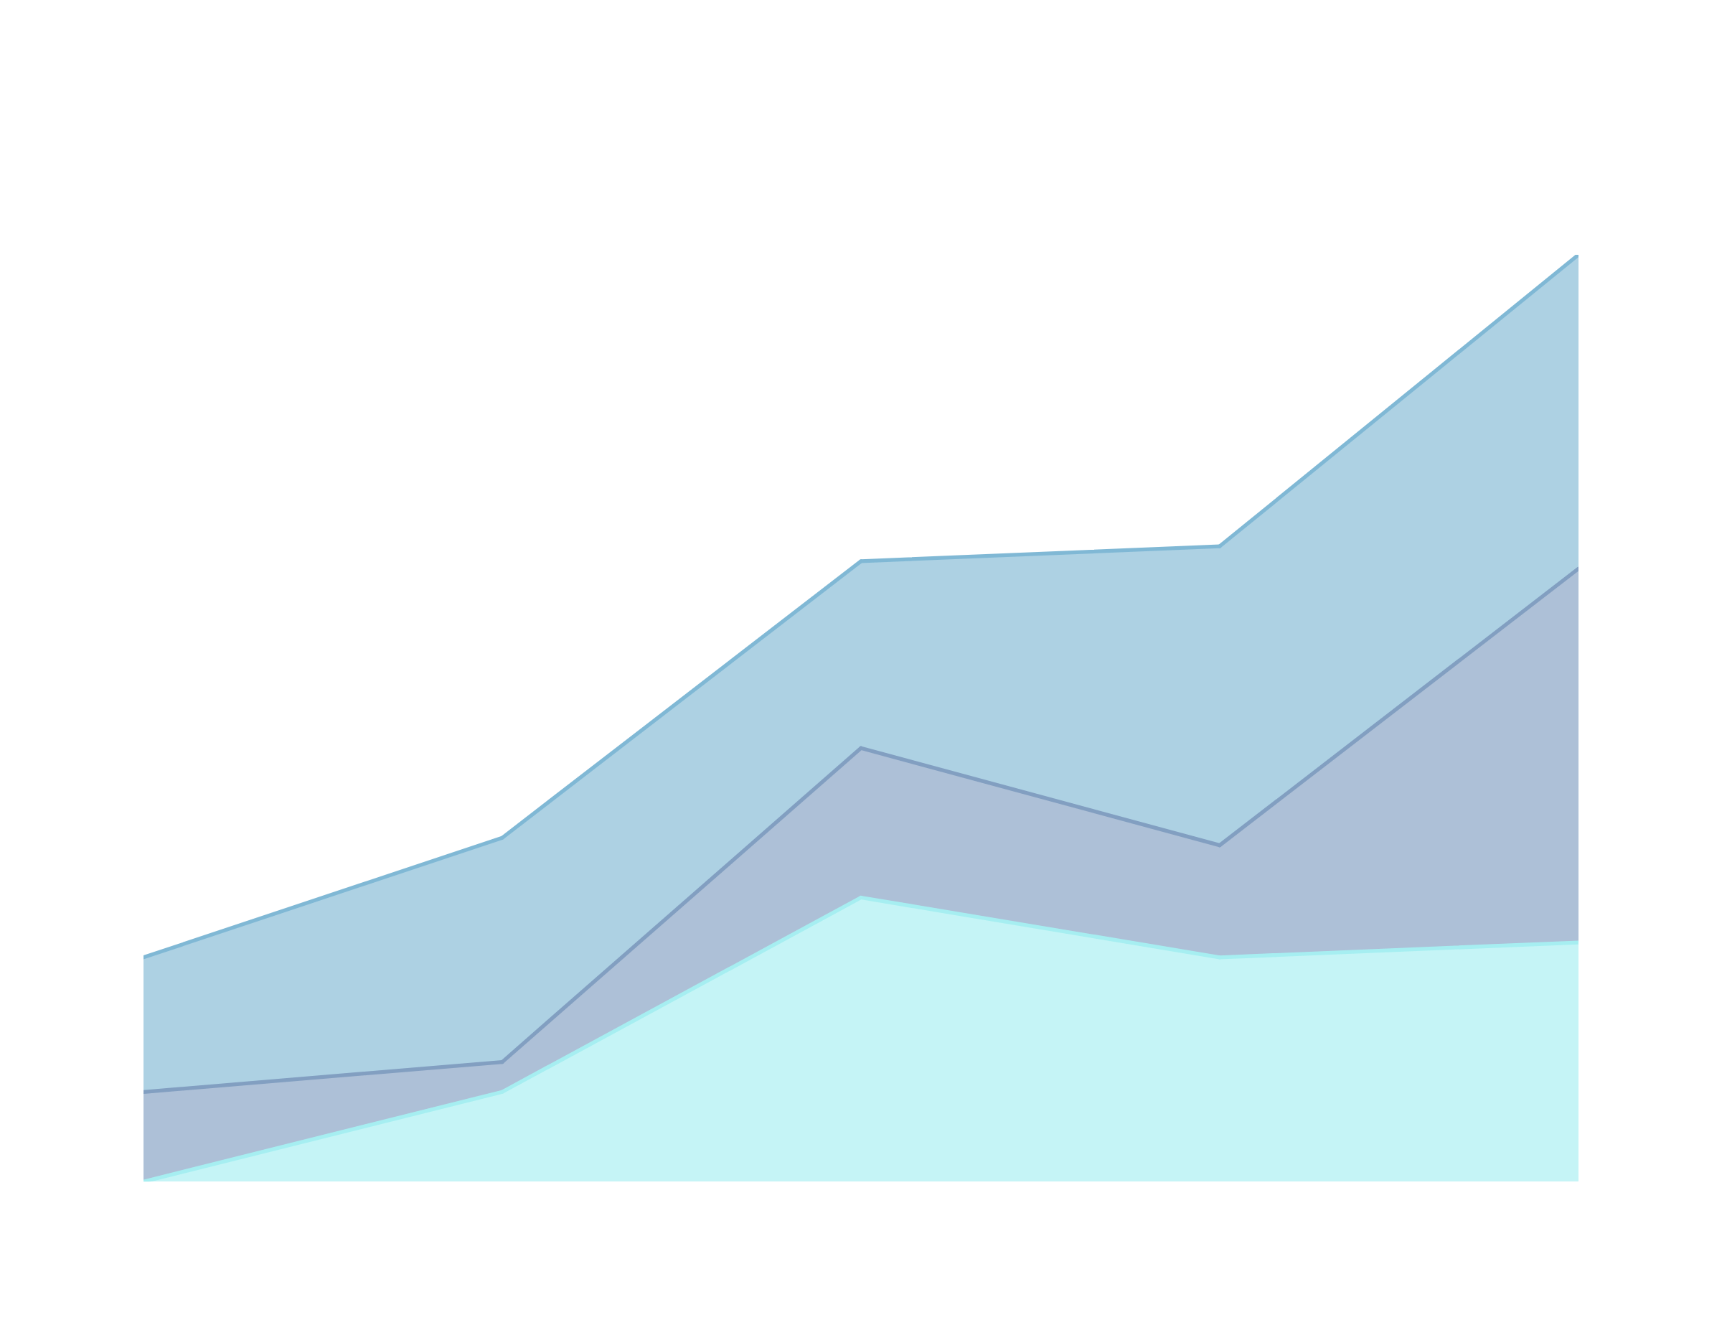
AI/ML LAB PROJECT
TEMPERATURE DETECTION FROM CLOUD COVER
CLOUD COVER:
Ayush Kumar Mishra,
Akshat Kumar,
Aditya Prakash
GITHUB REPOSITORY LINK

Slide 2

PROBLEM STATEMENT
Cloud coverage prediction serves as a crucial intermediate step in our
temperature prediction system. This phase focuses on developing accurate cloud coverage estimation using ground-based sky cameras and deep learning techniques.
Challenges Addressed:
Variability in cloud patterns.
Need for automated, accurate cloud coverage detection from images.
Goal:
Develop a scalable and accurate system for temperature prediction.

Slide 3

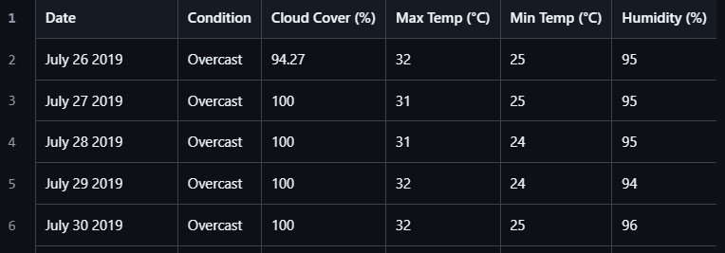
Dataset Overview
This dataset is created by collecting key attributes for detecting temperature from Weather.VisualCrossing.com, which we have aligned with cloud cover percentage for integration into our model implementation.

Slide 4
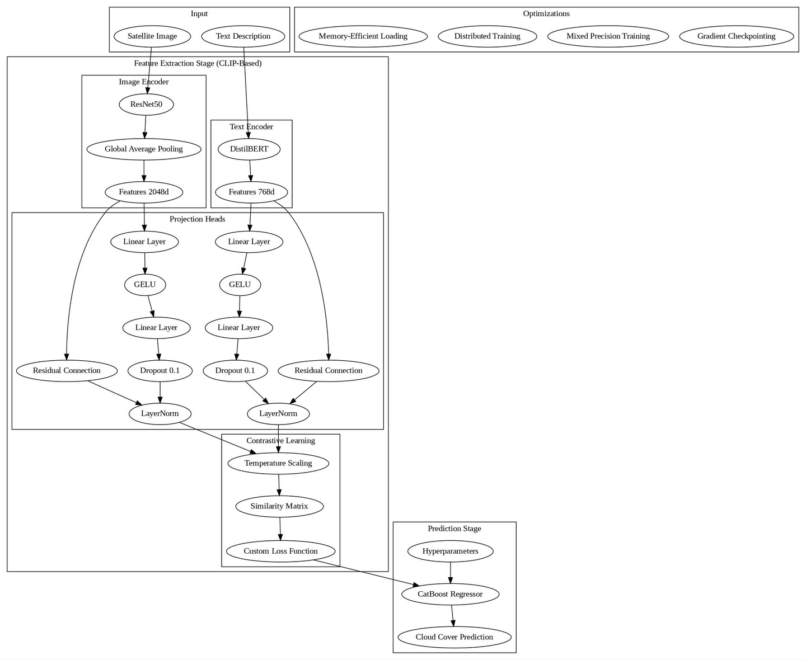
Model
Architecture
The pipeline combines CLIP-based feature extraction with CatBoost regression for cloud cover prediction:
Feature Extraction:
Image Encoder: Pre-trained ResNet50 (2048-dim features) with configurable layers.
Text Encoder: Pre-trained DistilBERT (768-dim features).
Projection Heads: Align image and text features into a 256-dim shared space using linear layers, GELU, and residual connections.
Loss Function: Temperature-scaled contrastive learning.
Prediction:
CatBoost Regressor: Trained on extracted features with 700 iterations, learning rate 0.1, and max depth 8 (RMSE optimized).
Optimizations:
Memory-efficient training, gradient checkpointing, and mixed precision support.
This modular pipeline efficiently predicts cloud cover using transfer learning and optimized regression.

Slide 5
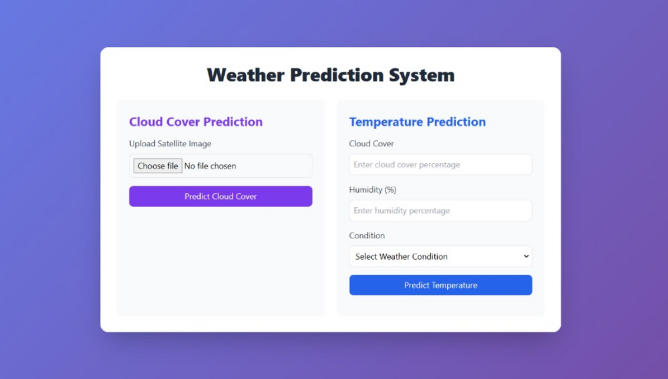
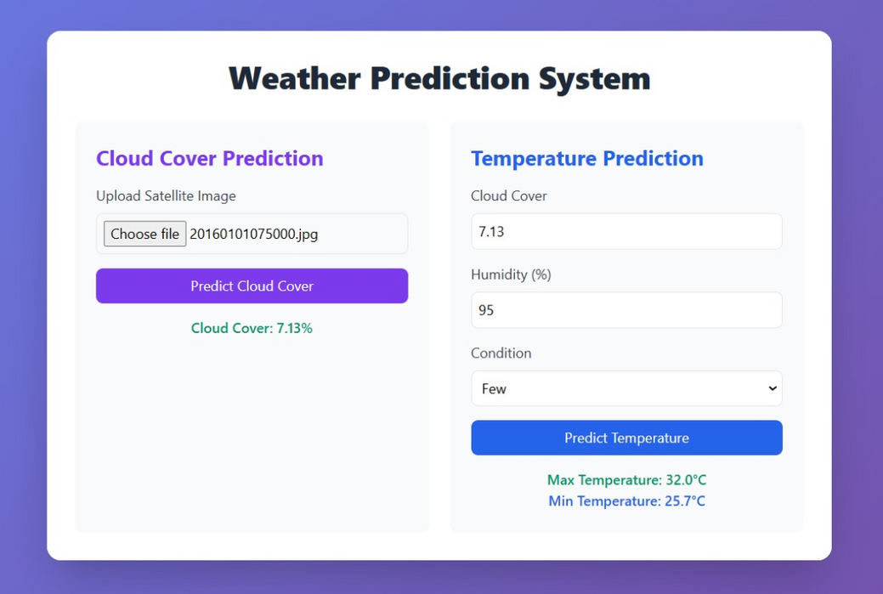
INFERENCE

Slide 6
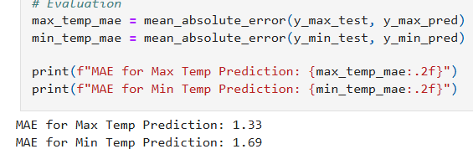
Results and Findings
Performance:
MAE for Max Temp Prediction: 1.33°C
MAE for Min Temp Prediction: 1.69°C
Insights:
Accurate predictions for both max and min temperatures, with slightly better performance for max temperatures.
Demonstrates acceptable approach for meteorological applications if worked on.
Future Scope:
Incorporate additional weather features to enhance accuracy.
Test on diverse datasets for broader applicability.

Slide 7
References
Cloud Coverage Prediction using Skycam Images
CLIP (Contrastive Language-Image Pretraining)
Team Contributions
AYUSH KUMAR MISHRA: Model architecture and code, and training.
AKSHAT KUMAR: Project design and code, report preparation.
ADITYA PRAKASH: Data scrapping and preprocessing .

Slide 8

TEAM CLOUD COVER

